Slide 1
Lightning Talk
By Don Vu & Emily Bui

Slide 2
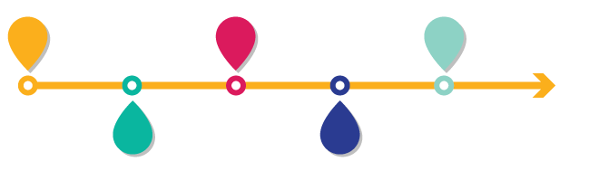
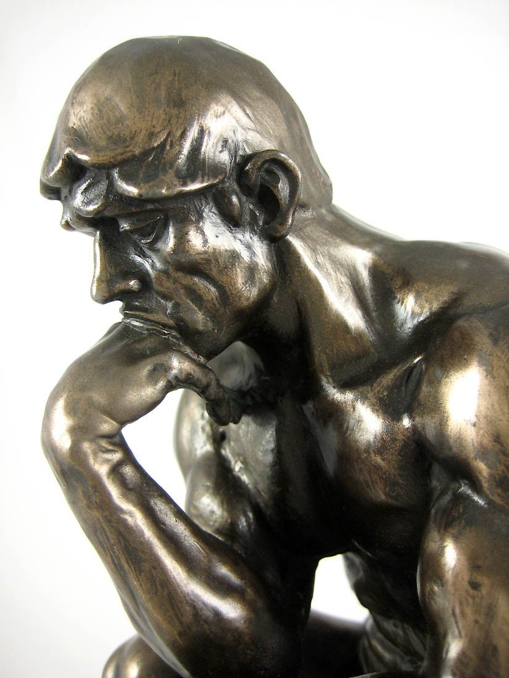

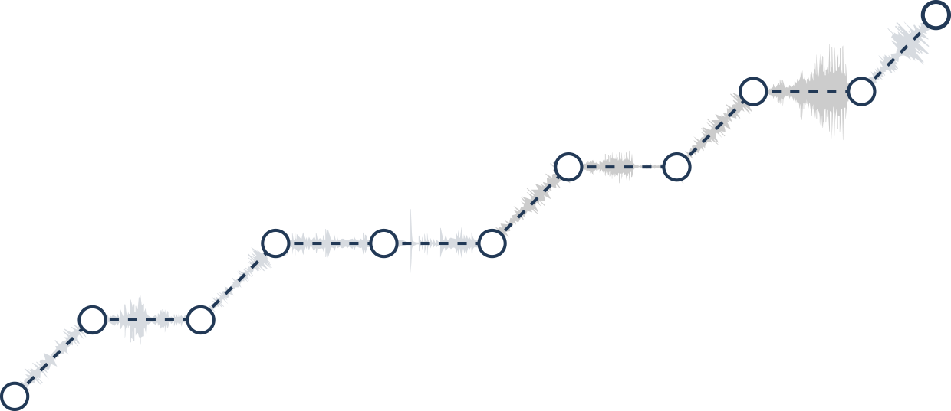

Slide 3
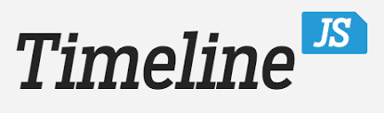
Introducing...

Slide 4
Beginning Functionalities

Slide 5
History
Created by Knight Lab at NorthWestern University
Zach Wise
Primarily intended for journalists
Useful for various disciplines
Became widely popular
Established Design Guideline & Methodical Software Dev. Process
In 2013, official home: https://timeline.knightlab.com/

Slide 6
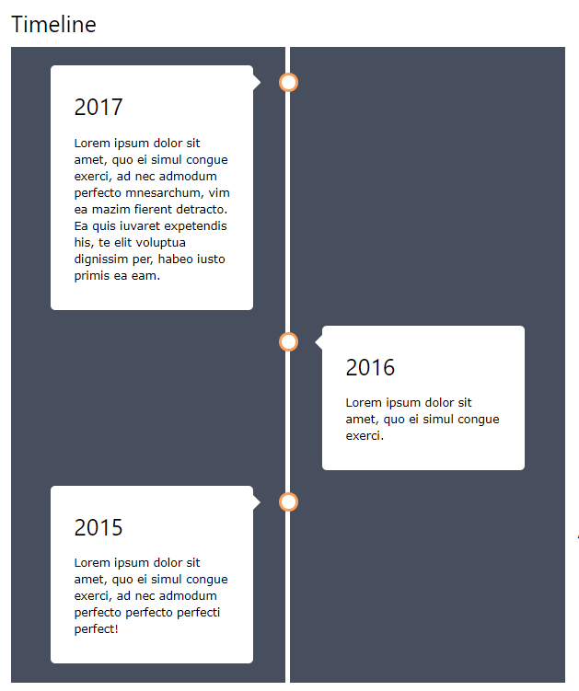
W3 School Comparison
“Responsive” Timeline w/ CSS
-Static; rather than dynamic, interactive

Slide 7
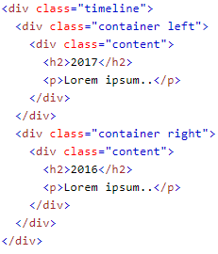
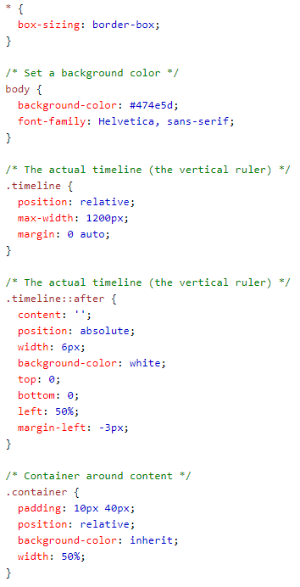
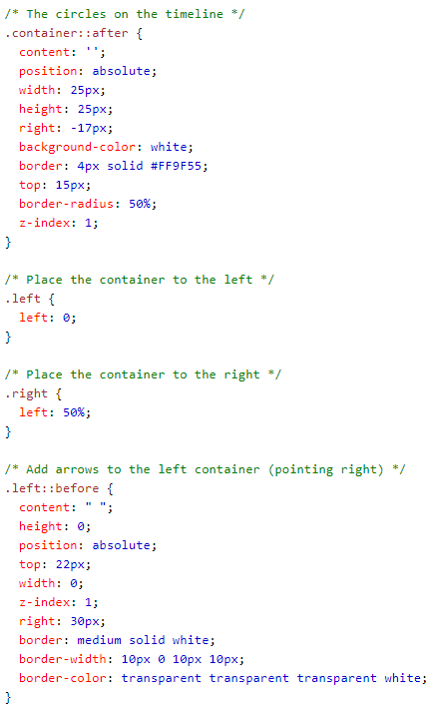

Slide 8
Installing
How to Start?

Slide 9
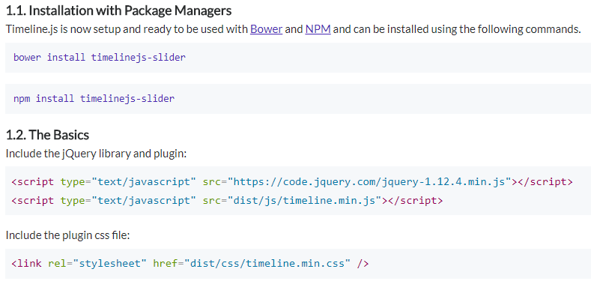

Slide 10
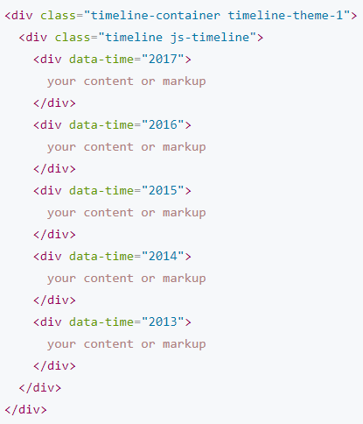
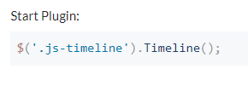
Simple HTML markup

Slide 11
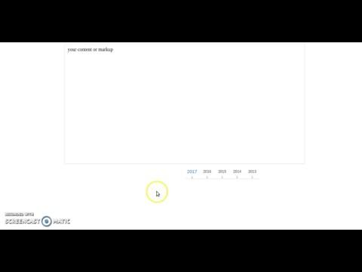
Simple Demo

Slide 12
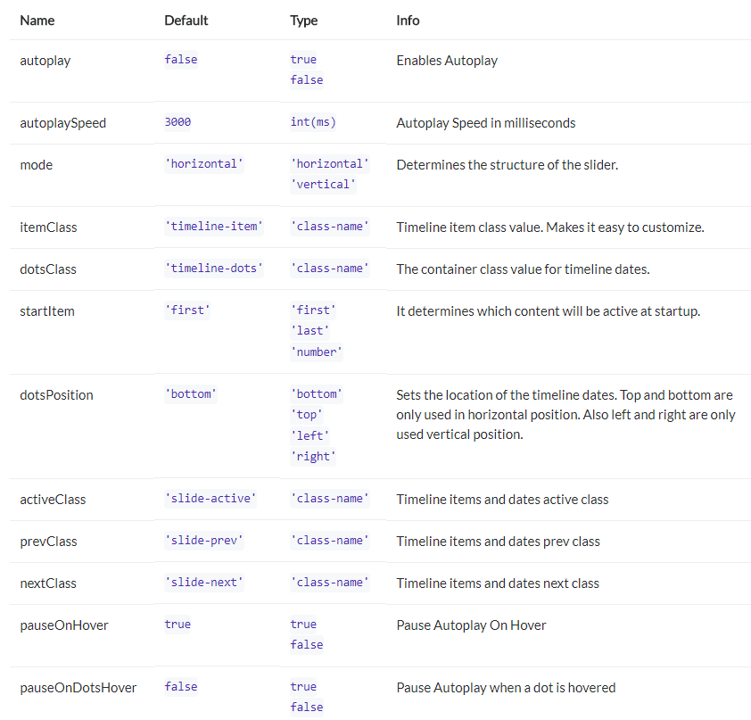
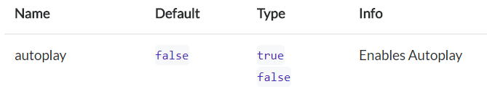

Future Options

Slide 13
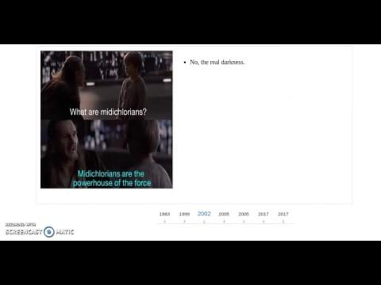

Slide 14
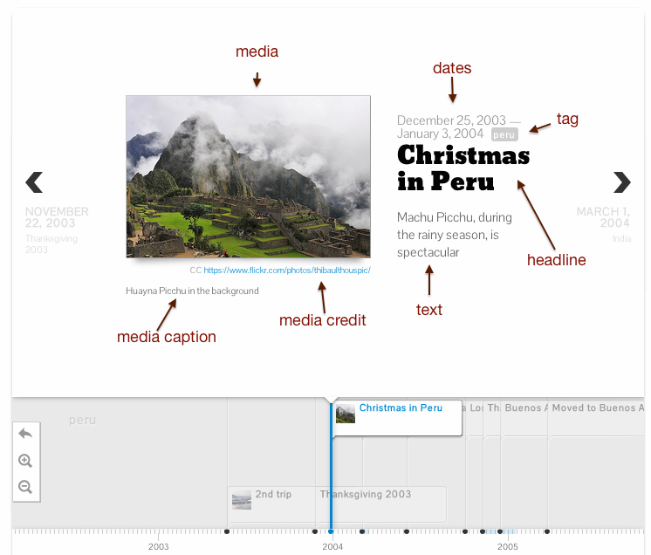
Knight Lab
Beginners use Google Sheets
Experts use JSON create custom installations
Steps:
1 ) Use Template
2 ) Fill Info in Column
3 ) Publish to Web
4 ) Embed Link

Slide 15
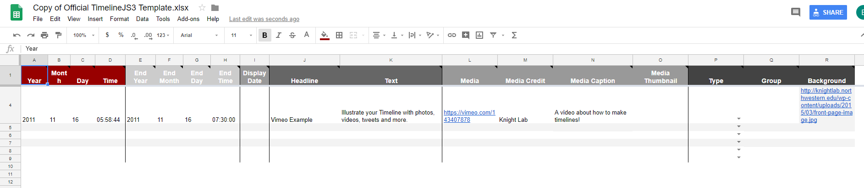
Timeline.js Template

Slide 16
FAQs
How to Edit?
Change spreadsheet, no publish again
Which Web Browsers?
Chrome, IE10
Change CSS?
Override using css selectors
<style> tags
Years before BCE
Use Negative values
Spreadsheet found by Search Engines?
Possible.
Free?
Mozilla Public License Ver. 2
Thing to Note:
If privacy is a concern and data not made public, do not use. Use JSON format and web server security measures to control access and data.

Slide 17
Tips:
Keep it Short
Pick Stories with a Strong Chronological Order
Write events as part of a Larger Narrative
Build Up to Major Occurrences, not only include major events

Slide 18
Eventually...

Slide 19
Credits
https://images-na.ssl-images-amazon.com/images/I/71zXw4Om1TL._SL1100_.jpg
http://med-fom-fmprpostgrad.sites.olt.ubc.ca/files/2016/02/Timeline-for-Scholarship-Projects.png
https://cdn0.iconfinder.com/data/icons/infographic-element-3/32/18_job_task_timeline_period_completion_manage_discussion-512.png
https://cdn4.iconfinder.com/data/icons/infographic-element-vol-2/32/1_job_task_timeline_period_completion_date_time_infographic-512.png
https://www.w3schools.com/howto/howto_css_timeline.asp
https://ilkeryilmaz.github.io/timelinejs/
https://timeline.knightlab.com/
http://almende.github.io/chap-links-library/js/timeline/doc/
https://knightlab.northwestern.edu/2013/09/23/timelinejs-now-with-even-more-knight-lab/

